Slide 1
Effective Retrieval of Resources in Folksonomies Using a New Tag Similarity Measure
Date : 2012/10/11
Resource : CIKM’11
Advisor : Dr. Jia-Ling Koh
Speaker : I-Chih Chiu

Slide 2
Outline
Introduction
Description of the approach
Tag similarity computation
Tag expansion
Taming computational complexity
Evaluation
Conclusion

Slide 3
Introduction
Social media application
Videos, pictures, music, blogs etc.
Pre-defined taxonomies
Social tagging
Informally defined
Continually changing
Ungoverned
Find content of interest has become a main challenge

Slide 4
Motivation
Various classic metrics have been used to compute tag similarity
Cosine similarity, Jaccard coefficient, Pearson correlation
The underlying folksonomy is already dense
This assumption does not hold true
Most real life folksonomies exhibit a power law distribution of tag usage
Using traditional metrics like cosine similarity, would almost always yield close-to-zero values

Slide 5
Goal
Propose an approach that transparently induces the creation of a dense folksonomy
mutual reinforcement principle
Automatically expand the user-selected tag set
Label a new resource
Submit a query to retrieve some resources
Tag similarity computation
Cosine
Latent sematic indexing
Tag expansion
It can automatically expand the tag set chosen by the user.
SimRank
The novel approach

Slide 6
Outline
Introduction
Description of the approach
Tag similarity computation
Tag expansion
Taming computational complexity
Evaluation
Conclusion

Slide 7
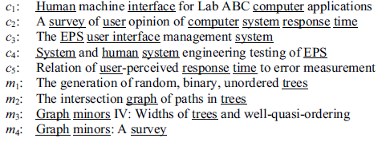
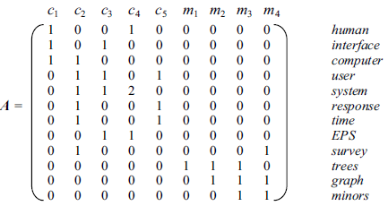
Cosine Similarity
Co-occurrence
Roughly 81% of resources were described by no more than 5 different tags (and roughly 58% by less than 3 )
Matrix TR is rather sparse
$$s\left(t_{i},t_{j}\right)=\frac{\left\langle t_{r}\left(i\right),t_{r}\left(j\right)\right\rangle }{\sqrt{\left\langle t_{r}\left(i\right),t_{r}\left(i\right)\right\rangle }∙\sqrt{t_{r}\left(j\right),t_{r}\left(j\right)}}$$
(1)
$$s\left(user,system\right)=\frac{2}{\sqrt{3}∙\sqrt{6}}=\frac{\sqrt{2}}{3}$$
$$s\left(time,EPS\right)=\frac{0}{\sqrt{2}∙\sqrt{2}}=0$$
TR =

Slide 8
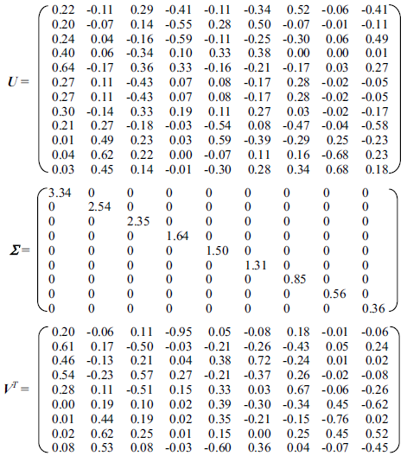
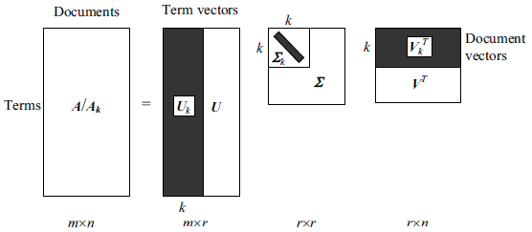
Latent Semantic Indexing(1/2)
Singular Value Decomposition(SVD)
$$A=UΣV^{T}$$
$$A=U_{k}Σ_{k}{V_{k}}^{T}$$
Notes:
LSA( 隱含語意分析)
是以統計的方式去解析某個字詞在文件間的接近程度, 使用LSA來分析而成的索引就是LSI(Latent Semantic Indexing
SVD(Singular Value Decomposition)
LSI 對SVD 做了一點改變，就是對Ʃ的r 個對角線元素進行了排序，並只保留前k 個值( k < r )， 後面r - k 個設0。

Slide 9
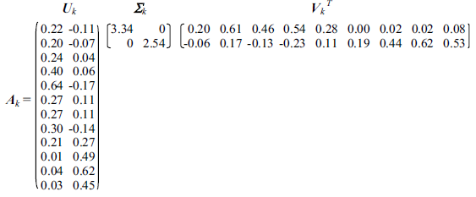
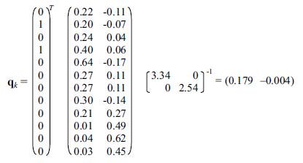
Latent Semantic Indexing(2/2)
$$A_{k}=U_{k}Σ_{k}{V_{k}}^{T}$$
$$k=2$$
q_{k} is then compared with every document vector in V_{k} using the cosine similarity.
The computation of LSI on large matrices is very costly
The tuning of parameter k is complex and time-expensive
$$q=U_{k}Σ_{k}{q_{k}}^{T}⇒{U_{k}}^{T}q=Σ_{k}{q_{k}}^{T}⇒$$
$${Σ_{k}}^{−1}{U_{k}}^{T}q={q_{k}}^{T}⇒q_{k}=q^{T}U_{k}{Σ_{k}}^{−1}$$
query q = “user interface”

Slide 10
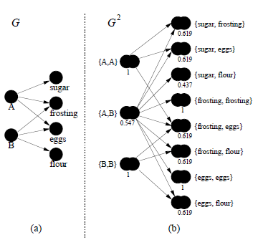
SimRank(1/2)
More suitable to the folksonomy domain are techniques that rely on the mutual reinforcement principle.
People are similar if they purchase similar items.
Items are similar if they are purchased by similar people.
$$s\left(A,B\right)=\frac{C_{1}}{|O(A)||O(B)|}\sum_{i=1}^{|O(A)|}{\sum_{j=1}^{|O(B)|}{s(O_{i}(A),O_{j}(B))}}$$
$if A≠B,$
(2)
$$s\left(A,B\right)=\frac{0.8}{3∗3}∗\left(0.619∗6+1+1+0.437\right)=0.547$$
$$s\left(c,d\right)=\frac{C_{2}}{|I(c)||I(d)|}\sum_{i=1}^{|I(c)|}{\sum_{j=1}^{|I(d)|}{s(I_{i}(c),I_{j}(d))}}$$
$if c≠d,$
(3)
$$s\left(frosting,eggs\right)=\frac{0.8}{2∗2}∗\left(1+1+0.547∗2\right)=0.619$$

Slide 11
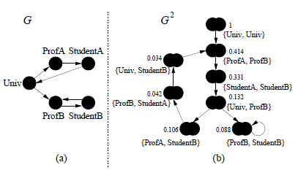
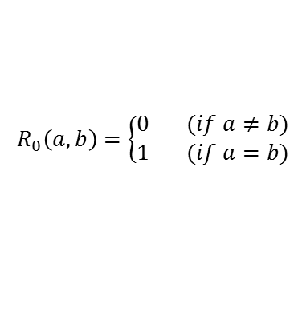
SimRank(2/2)
Iteration
Don’t consider the number of times a tag intervenes in labeling a resource
Don’t distinguish between tags that have labeled exactly the same resource
$$R_{3}\left(Univ,ProB\right)=\frac{0.8}{1∗2}\sum_{i=1}^{1}{\sum_{j=1}^{2}{R_{2}(I_{i}(Univ),I_{j}(ProB))}}$$
$$R_{2}\left(StudA,StudB\right)=\frac{0.8}{1∗1}\sum_{i=1}^{1}{\sum_{j=1}^{1}{R_{1}(I_{i}(StudA),I_{j}(StudB))}}$$
$$R_{2}(StudA,Univ)$$
$$R_{1}\left(ProfA,ProfB\right)=\frac{0.8}{1∗2}\sum_{i=1}^{1}{\sum_{j=1}^{2}{R_{0}(I_{i}(ProfA),I_{j}(ProfB))}}$$
$$R_{0}\left(a,b\right)=\left\{\begin{aligned}0 (if a≠b) \\ 1 (if a=b)\end{aligned}\right.$$
$$R_{0}\left(Univ,Univ\right)=1$$
$$R_{0}\left(Univ,StudB\right)=0$$
$$R_{k+1}\left(a,b\right)=\frac{C}{|I(a)||I(b)|}\sum_{i=1}^{|I(a)|}{\sum_{j=1}^{|I(b)|}{R_{k}(I_{i}(a),I_{j}(b))}}$$
$$R_{3}\left(Univ,ProB\right)=0.128$$
(4)

Slide 12

A Novel Similarity Metric(1/2)
Mutual reinforcement factor $(ψ)$
To give more relevance to tags that labeled the very same resources, with respect to those that labeled related (but not the very same) resources.
$Ψ$ is equal to 1 if $i=j$, while it is equal to $ψ$ if $i≠j$.
$st^{0}\left(t_{a},t_{b}\right)=δ_{ab}$ $sr^{0}\left(r_{a},r_{b}\right)=δ_{ab}$
(5)
Cosine similarity
$$st^{k}\left(t_{a},t_{b}\right)=\frac{ST^{k}(t_{a},t_{b})}{\sqrt{ST^{k}(t_{a},t_{a})}∙\sqrt{ST^{k}(t_{b},t_{b})}}$$
$$sr^{k}\left(r_{a},r_{b}\right)=\frac{SR^{k}(r_{a},r_{b})}{\sqrt{SR^{k}(r_{a},r_{a})}∙\sqrt{SR^{k}(r_{b},r_{b})}}$$
(6)
(7)
$$ST^{k}\left(t_{a},t_{b}\right)=\sum_{i,j=1}^{n_{r}}{TR_{ai}∙Ψ_{ij}∙sr^{k−1}(r_{i},r_{j})∙TR_{bj}}$$
$$SR^{k}\left(r_{a},r_{b}\right)=\sum_{i,j=1}^{n_{t}}{TR_{ia}∙Ψ_{ij}∙st^{k−1}(t_{i},t_{j})∙TR_{jb}}$$
(8)
(9)

Slide 13
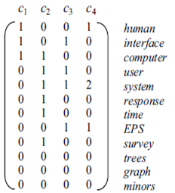
A Novel Similarity Metric(2/2)
How to compute the similarity of $st^{1}(human,interface)$
$$st^{0}\left(human,interface\right)=\frac{1}{\sqrt{2}\sqrt{2}}=\frac{1}{2}$$
$$st^{1}\left(human,interface\right)=\frac{ST^{1}(h,i)}{\sqrt{ST^{1}(h,h)}∙\sqrt{ST^{1}(i,i)}}$$
TR =
${ST}^{1}\left(h,i\right)=1+0+0.6∗\frac{1}{\sqrt{12}}+0+0.6∗\frac{1}{\sqrt{18}}+0+0.6∗\frac{3}{\sqrt{24}}$=1.438
$$ST^{1}\left(h,h\right)=1+0.6∗\frac{1}{\sqrt{18}}+0.6∗\frac{1}{\sqrt{18}}+1=2.288$$
$$ST^{1}\left(i,i\right)=1+0.6∗\frac{1}{\sqrt{12}}+0.6∗\frac{1}{\sqrt{12}}+1=2.348$$
$$ST^{k}\left(t_{a},t_{b}\right)=\sum_{i,j=1}^{n_{r}}{TR_{ai}∙Ψ_{ij}∙sr^{k−1}(r_{i},r_{j})∙TR_{bj}}$$
$$st^{1}\left(human,interface\right)=\frac{1.438}{\sqrt{2.288}∙\sqrt{2.348}}=\frac{1.438}{2.318}=0.62$$

Slide 14
Tag expansion(1/2)
Key to their approach is the use of the previously computed tag similarities to automatically expand the tag set chosen by the user.
$$SC\left(t_{i},tSet\right)=\sum_{t_{j}∈tSet}{sc(t_{i},t_{j})}$$
(10)
$tSet=\left\{t_{1},…,t_{n}\right\}$ is the set of user-selected tags
$t_{j}$ is a tag in $tSet$ and $t_{i}$ a tag not in $tSet$
Largely used
Important
$$sc\left(t_{i},t_{j}\right)=st(t_{i},t_{j})∙\log{count(t_{i})∙IRF(t_{i})}$$
(11)
$st(t_{i},t_{j})$ : the previously computed similarity
$count(t_{i})$ : the number of times $t_{i}$ appears in the folksonomy
$IRF(t_{i})$ : the inverse resource frequency of $t_{i}$

Slide 15
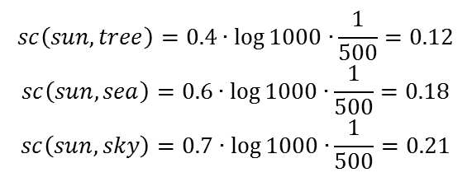
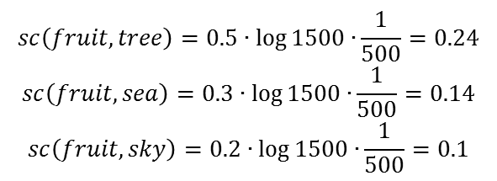
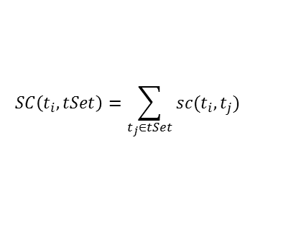
Tag expansion(2/2)
$$SC\left(t_{i},tSet\right)=\sum_{t_{j}∈tSet}{sc(t_{i},t_{j})}$$
$$sc\left(t_{i},t_{j}\right)=st(t_{i},t_{j})∙\log{count(t_{i})∙IRF(t_{i})}$$
Assume $tSet$ = {tree, sea, sky}
{sun, fruit} : not choose by user
$$sc\left(sun,tree\right)=0.4∙\log{1000∙}\frac{1}{500}=0.12$$
$$sc\left(sun,sea\right)=0.6∙\log{1000∙}\frac{1}{500}=0.18$$
$$sc\left(sun,sky\right)=0.7∙\log{1000∙}\frac{1}{500}=0.21$$
$$SC\left(sun,tSet\right)=$$
$$0.12+0.18+0.21=0.51$$
$$sc\left(fruit,tree\right)=0.5∙\log{1500∙}\frac{1}{500}=0.24$$
$$sc\left(fruit,sea\right)=0.3∙\log{1500∙}\frac{1}{500}=0.14$$
$$sc\left(fruit,sky\right)=0.2∙\log{1500∙}\frac{1}{500}=0.1$$
$$SC\left(fruit,tSet\right)=$$
$$0.24+0.14+0.1=0.48$$
Recommend top k highest scoring tags and users can decide which one to use.

Slide 16
Computational complexity
From a theoretical standpoint, the computation of each pairwise tag similarity may require an infinite number of iterations.
This could make our similarity measure inapplicable in practical cases, because each iteration would require exactly $n{}_{r}^{2}{×n{}_{t}^{2} }$ computations.

Slide 17
Outline
Introduction
Description of the approach
Tag similarity computation
Tag expansion
Taming computational complexity
Evaluation
Conclusion

Slide 18
Evaluation
Is our approach able to increase the accuracy of searches?
Does our approach scale to large folksonomies?

Slide 19
Datasets
Bibsonomy & CiteULike
 | Bibsonomy | CiteULike
Bookmarks | 648,924 | 2,281,609
User | 4,696 | 57,053
Papers | 578,587 | 1,928,302
Distinct tags | 147,076 | 401,620

Slide 20
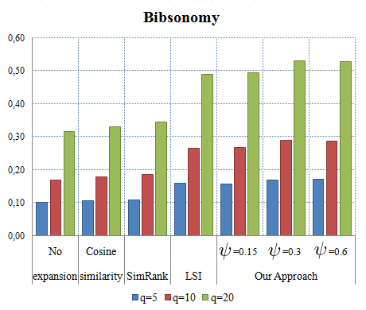
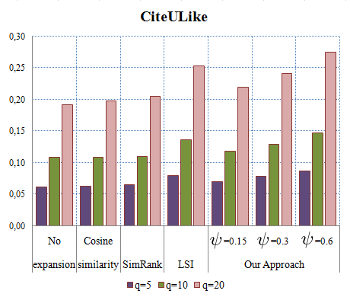
Accuracy of User Searches
The first experiment aimed at determining the ability of the approach to retrieve resources of relevance to the user querying the folksonomy.
Tag expansion can yield better results
Figure 1: Retrieved Ratio on Bibsonomy and CiteULike
Notes:
due to the number of synonyms, homonyms and polysemies, as well as the heterogeneity of users, r could have been described by users with different tags.

Slide 21
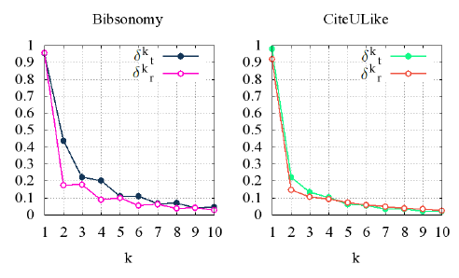
Scalability
As previously pointed out, the highest cost caused by the approach lies in the computation of pairwise tag similarities.
This result confirms that their similarity measure is scalable and well suited to be applied even when operating in large folksonomies.
(12)

Slide 22
Outline
Introduction
Description of the approach
Tag similarity computation
Tag expansion
Taming computational complexity
Evaluation
Conclusion

Slide 23
Conclusion
Have proposed an approach that enables the effective retrieval of resources within folksonomies.
This metric is used both when users label resources and when users query the folksonomy.
Finally, the computational cost of our iterative approach is limited, as convergence is guaranteed, and in practice reached after a handful of iterations.

Slide 24
Thanks for listening

